Slide 1
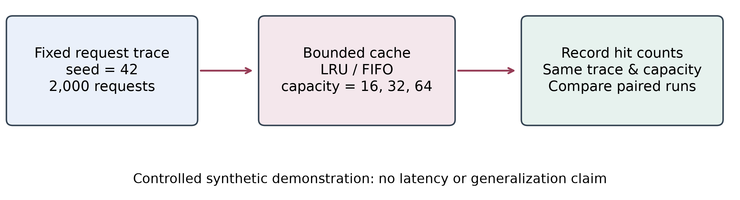
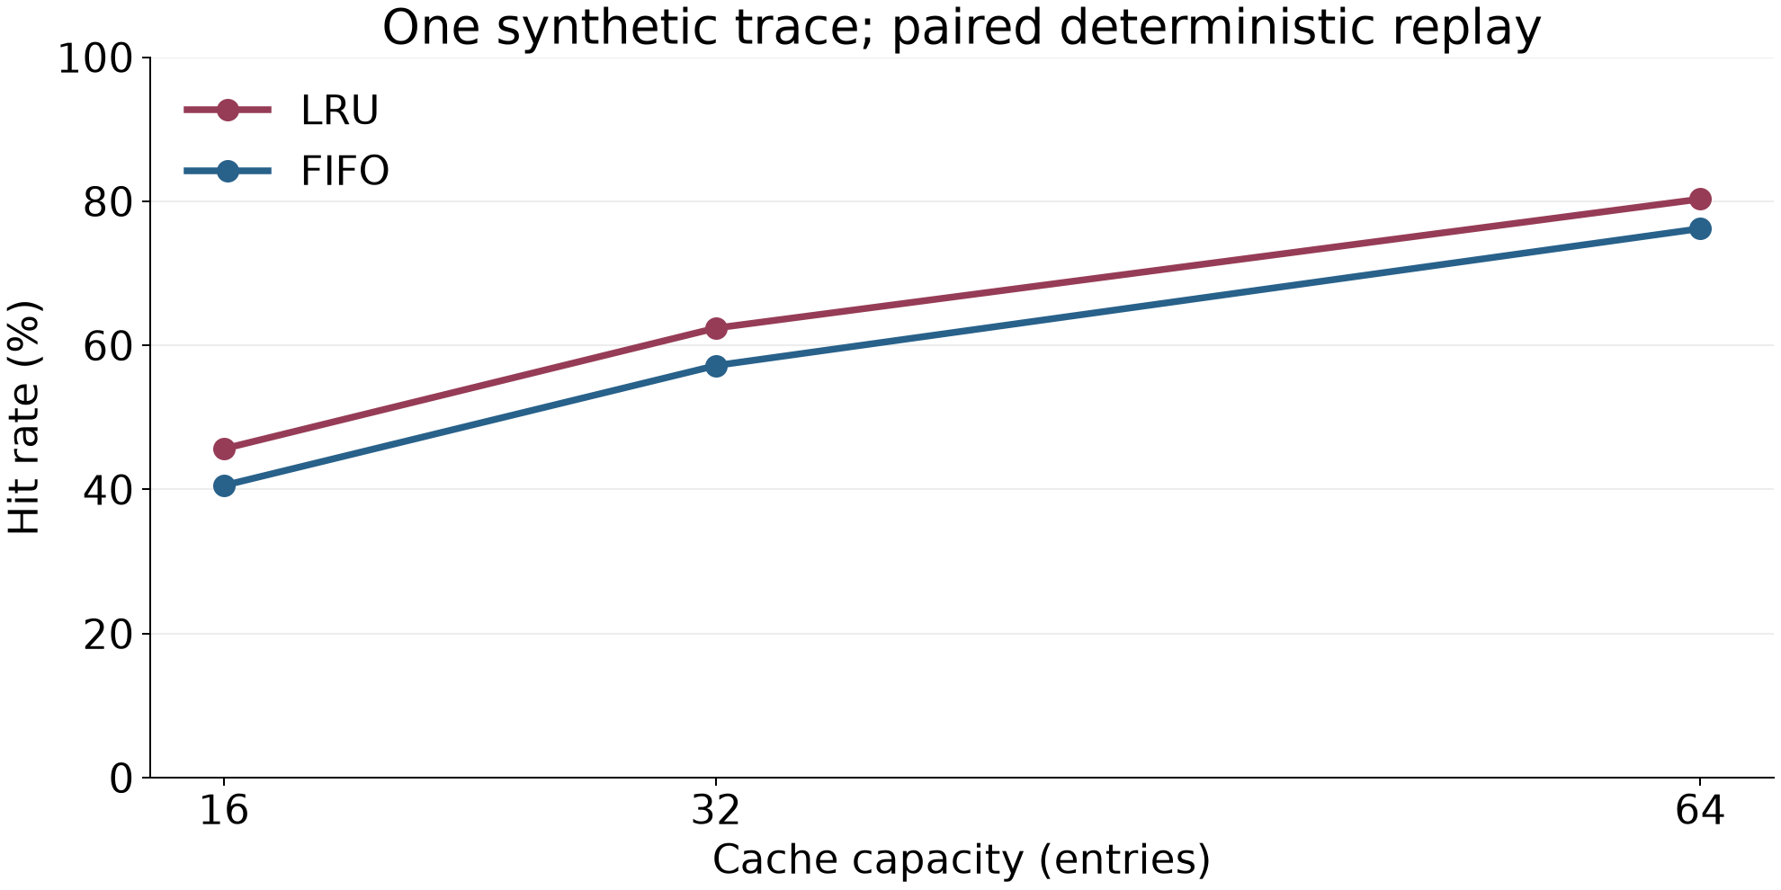
Comparing Cache Replacement Policies with Paired Synthetic Replay
SciPepper · Controlled synthetic demonstration · Seed 42 / 2,000 requests
Research question
Controlled comparison
How do LRU and FIFO behave under the same capacity constraint?
Compare replacement rules using a shared request trace, identical
capacities and an empty starting state.
The aim is a transparent, reproducible comparison. All values below
come from synthetic replay; they are not measurements from a
production system.
A hit means the requested key is present before the current access. Rate
equals the recorded hit count divided by 2,000; cold-start accesses
remain in the denominator.
Hold request order, key universe, capacity and initial state constant. The
replacement rule is the only changed condition. One generated
workload is evaluated; repeated seeds and confidence intervals are
outside this demonstration.
Source p. 1
Method: paired trace replay
Source p. 3
Generate 2,000 requests over 128 keys with seed 42 and weights
proportional to 1 / (key + 1). Replay the identical sequence at capacities
of 16, 32 and 64 entries.
LRU updates recency after a hit; FIFO preserves insertion order. Both
evict one entry before inserting into a full cache. Record hits; do not
measure execution time.
Results on the synthetic trace
LRU: 913, 1248, 1606 hits at capacities 16, 32, 64. FIFO: 811, 1144, 1524
hits under the same conditions. The plot uses these exact counts and a
fixed denominator of 2,000.
The rates describe one synthetic trace. No latency, throughput or
statistical significance measurement was performed.
Source p. 2
Source p. 4
Interpretation & limitations
Pairing the workload and capacity makes the comparison inspectable. Preserve conditions beside the result figure and avoid converting a source-
specific observation into a general scientific claim.
One synthetic seed does not cover real access patterns, concurrency or retrieval cost. A stronger study would need multiple workloads, repeated
trials and uncertainty analysis. This example verifies layout and provenance only.
Source p. 5
synthetic-cache-poster.pdf
Notes:
Research question
How do LRU and FIFO behave under the same capacity constraint? Compare replacement rules using a shared request trace, identical capacities and an empty starting state.
Method: paired trace replay
Generate 2,000 requests over 128 keys with seed 42 and weights proportional to 1 / (key + 1). Replay the identical sequence at capacities of 16, 32 and 64 entries.
Controlled comparison
A hit means the requested key is present before the current access. Rate equals the recorded hit count divided by 2,000; cold-start accesses remain in the denominator.
Results on the synthetic trace
LRU: 913, 1248, 1606 hits at capacities 16, 32, 64. FIFO: 811, 1144, 1524 hits under the same conditions. The plot uses these exact counts and a fixed denominator of 2,000.
Interpretation & limitations
Pairing the workload and capacity makes the comparison inspectable. Preserve conditions beside the result figure and avoid converting a source-specific observation into a general scientific claim.

